Slide 1
Scientific Methods

Slide 2
Agenda
Design Criteria for Methods
Applying Design Criteria
Methods Starter Package
Methods in the Responsibility Module
Ressources

Slide 3
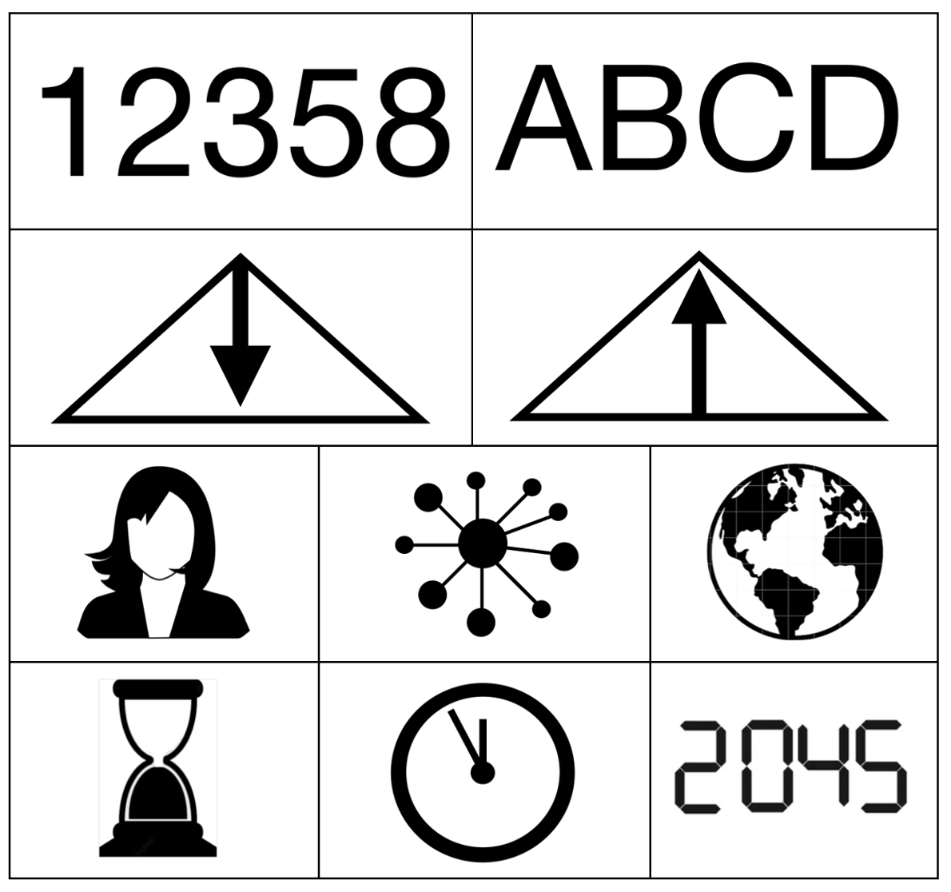
Design Criteria for Methods
Notes:
It is best to ask the students once whether they have essentially understood the design criteria. They learnt about them in week 2 in the methods lecture.
If there are still uncertainties, perhaps one of the students present can explain the criteria or answer questions. Please explain the concept yourself if necessary. It is important to note that methods can process/generate different data and can therefore be used in different contexts, depending on what knowledge is required. As a refresher, you can read up again here: https://sustainabilitymethods.org/index.php/Design_Criteria_of_Methods#What_are_scientific_methods.3F (especially ‘What are scientific methods?’ with the subchapters Quantitative/Qualitative, Inductive/Deductive, Spatial and Temporal Scales). You can use the illustration above for visualisation.

Slide 4
Projects of the Conference Week 2024
‘Inclusive residential communities: social integration and personal development’
  The research project focusses on inspiring stories of people with different backgrounds and abilities who live together in housing projects. How can they live together successfully?
‘Headline spectacle around the Last Generation’
  The students analyse the framing and narratives in newspaper articles that have reported on the Last Generation. Does the reporting remain neutral or does it steer readers in a certain direction?
‘Human rights violations and environmental impacts in global agricultural supply chains using the example of the Chiquita Group’
  The Swiss company Chiquita is one of the market leaders in the banana trade. But where does the produce come from and under what conditions is it harvested?
Notes:
The students should now apply the design criteria. Three examples are listed here. These are projects by students from the responsibility module that were presented at the 2024 conference week. 2 of them were even awarded a salt crystal.
Go through the projects once with the students and think about which design criteria were relevant when designing the research project for each one. Sometimes there is not just one right solution, but we would suggest the following categorisation:
Inclusive living communities: qualitative - inductive - individual/system - present
→ Data would probably be collected here using interviews or focus group interviews. A social network analysis would also be conceivable (this would then be quantitative)
Headline spectacle: qualitative - inductive - system - past
→ A qualitative content analysis was probably carried out here to analyse the narratives in the articles.
Chiquita: qualitative/quantitative - inductive/deductive - system/global - present
→ For the ecological consequences, a life cycle analysis or supply chain analysis (both quantitative) could be used. For the human rights violations, a qualitative approach could be used again (e.g. with interviews)
The aim of the exercise is to familiarise students with the design criteria for methods and to give them a feeling for the fact that they need different methods for different objects of investigation and that they also generate different knowledge with different methods.

Slide 5
Methods Starter Package
Simple methods which can be learned in the first semester
  Can be applied in the Responsibility Project
https://wiki-methods.vercel.app/starter-package
Notes:
Please introduce students to the starter pack for methods. These are 16 selected methods that first-semester students can learn and use in their responsibility projects.
Show the students the tool once on the projector, then they can try it out for themselves.

Slide 6
Methods in the Responsibility Project
Get together in small groups (3-4)
Which methods from the starter package could you use in your responsibility project?
Examples:
  Seminar: Climate adaptation in Hamburg. -> future-oriented method
  Seminar: Sustainable supply chains in the technology sector. -> system level
Notes:
Die Studierenden sollen überlegen, welche Methoden Sie in ihren Projekten im Verantwortungsseminar anwenden können.
Einige Studierende werden schon ein Thema/eine Methode haben, sie können dann die anderen beim Brainstormen unterstützen.

Slide 7
Ressources
More Methods: https://sustainabilitymethods.org/index.php/Methods

Slide 8
Questions?

Slide 9
See you next week!

